Slide 1
Day 01:
Introduction to Analytics

Slide 2
Analysis Definition

Slide 3
ANALYSIS
A systematic examination and evaluation of data or information, by breaking it into its component parts to uncover their interrelationships. It is the opposite of synthesis.
An examination of data and facts to uncover and understand cause-effect relationships, thus providing basis for problem solving and decision making.

Slide 4
Analytics Definition

Slide 5
ANALYSIS
It involves studying past historical data to research potential trends, to analyse the effects of certain decisions or events, or to evaluate the performance of a given tool or scenario.
The goal of analytics is to improve the business by gaining knowledge which can be used to make improvements or changes.
Financial ANALYTICS:
In the Banking and Financial Services sector, through data analytics, institutions can monitor and assess large amounts of customer data and create personalized/customized products and services specific to individual consumers.
MARKETING ANALYTICS:
Marketing analytics is the practice of measuring, managing and analysing marketing performance to maximize its effectiveness and optimize return on investment (ROI).

Slide 6
Differences

Slide 7
Analysis is the separation of a whole into its component parts, and analytics is the method of logical analysis.
Organisations leverage both to drive all types of decisions, and each specific application supports the unique insight challenges inherent in dissecting customer behaviours.
One way to distinguish the difference between analysis and analytics is to think in terms of past and future:
Analysis looks backwards over time, providing marketers with a historical view of what has happened.
Typically, analytics look forward to model the future or predict a result.

Slide 8
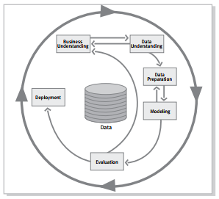
The Cross Industry Standard Process for Data Mining
Business understanding - This initial phase focuses on understanding the project objectives and requirements from a business perspective, then converting this knowledge into a data mining problem definition and a preliminary plan designed to achieve the objectives.
Data understanding- The data understanding phase starts with initial data collection and proceeds with activities that enable you to become familiar with the data, identify data quality problems, discover first insights into the data, and/or detect interesting subsets to form hypotheses regarding hidden information.
Data preparation - The data preparation phase covers all activities needed to construct the final dataset [data that will be fed into the modeling

Slide 9
tool(s)] from the initial raw data. Tasks include table, record, and attribute selection, as well as transformation and cleaning of data for modeling tools.
Modeling - In this phase, various modeling techniques are selected and applied, and their parameters are calibrated to optimal values. Typically, there are several techniques for the same data mining problem type. Some techniques have specific requirements on the form of data. Therefore, going back to the data preparation phase is often necessary.
Evaluation - At this stage in the project, you have built a model (or models) that appears to have high quality from a data analysis perspective. Before proceeding to final deployment of the model, it is important to thoroughly evaluate it and review the steps executed to create it, to be certain the model properly achieves the business objectives. A key objective is to determine if there is some important business issue that has not been sufficiently considered
Deployment - Creation of the model is generally not the end of the project. Even if the purpose of the model is to increase knowledge of the data, the knowledge gained will need to be organized and presented in a way that the customer can use it. It often involves applying “live” models within an organization’s decision making processes—for example, real-time personalization of Web pages or repeated scoring of marketing databases.

Slide 10
Agenda : Data Treatments

Slide 11
Data Collections

Slide 12
DATA
1: Factual information (such as measurements or statistics) used as a basis for reasoning, discussion, or calculation
2: Information output by a sensing device or organ that includes both useful and irrelevant or redundant information and must be processed to be meaningful
3: Information in numerical / qualitative form that can be digitally transmitted or processed

Slide 13
DATA SOURCES
A data source is simply the source of data. It can be a file, a particular database on a DBMS, or even a live data feed. The data might be located on the same computer as the program, or on another computer somewhere on a network.
For example, a data source might be an Oracle DBMS running on an OS/2® operating system, accessed by Novell® Netware; an IBM DB2 DBMS accessed through a gateway; or a collection of Xbase files in a server directory.
The purpose of a data source is to gather all of the technical information needed to access the data — the driver name, network address, network software, and so on — into a single place and hide it from the user.
The user should be able to look at a list that includes Payroll, Inventory, and Personnel, choose Payroll from the list, and have the application connect to the payroll data, all without knowing where the payroll data resides or how the application got to it.

Slide 14
The term data source should not be confused with similar terms. DBMS or database refers to a database program or engine.
A further distinction is made between desktop databases, designed to run on personal computers and often lacking in full SQL and transaction support, and server databases, designed to run in a client/server situation and characterized by a stand-alone database engine and rich SQL and transaction support.
Database also refers to a particular collection of data, such as a collection of Xbase files in a directory or a database on SQL Server. It is generally equivalent to the term catalogue, used elsewhere in this manual, or the term qualifier in earlier versions of ODBC.

Slide 15
DATA COLLECTION
Data collection is the systematic approach to gathering and measuring information from a variety of sources to get a complete and accurate picture of an area of interest.
Data collection enables a person or organization to answer relevant questions, evaluate outcomes and make predictions about future probabilities and trends.
Accurate data collection is essential to maintaining the integrity of research, making informed business decisions and ensuring quality assurance.
For example, in retail sales, data might be collected from mobile applications, website visits, loyalty programs and online surveys to learn more about customers.

Slide 16
DATA COLLECTION METHODS
Primary instruments for collecting information:
Surveys
Interviews
Focus groups
Today, with help from Web and analytics tools, organizations are also able to collect data from:
mobile devices
website traffic
server activity
other relevant sources, depending on the project

Slide 17
BIG DATA AND DATA COLLECTION
Big data describes voluminous amounts of structured, semi-structured and unstructured data collected by organizations. But because it takes a lot of time and money to load big data into a traditional relational database for analysis, new approaches for collecting and analyzing data have emerged.
To gather and then mine big data for information, raw data with extended metadata is aggregated in a data lake. From there, machine learning and artificial intelligence programs use complex algorithms to look for repeatable patterns.

Slide 18
Data Dictionary

Slide 19
DATA DICTIONARY
A data dictionary is a collection of descriptions of the data objects or items in a data model for the benefit of programmers and others who need to refer to them.
A first step in analyzing a system of objects with which users interact is to identify each object and its relationship to other objects. This process is called data modelling and results in a picture of object relationships.
After each data object or item is given a descriptive name, its relationship is described (or it becomes part of some structure that implicitly describes relationship), the type of data (such as text or image or binary value) is described, possible predefined values are listed, and a brief textual description is provided. This collection can be organized for reference into a book called a data dictionary.

Slide 20
CREATING THE DATA DICTIONARY
When one uses the Database Configuration Assistant to create a database, Oracle automatically creates the data dictionary. Thereafter, whenever the database is in operation, Oracle updates the data dictionary in response to every DDL statement.
The data dictionary base tables are the first objects created in any Oracle database. They are created in the SYSTEM table space and must remain there. The data dictionary base tables store information about all user-defined objects in the database.
Table B-1 lists required scripts, which are run automatically when one creates a database using the Database Configuration Assistant. They are described here because one might need to run them if one creates a database manually. To run these scripts, one must be connected to Oracle as a user with SYSDBA privileges.

Slide 21
TYPES OF DATA
Generally, there are two types of data:
Quantitative data: any data that is in numerical form – e.g., statistics and percentages.
Qualitative data: all the descriptive data. For e.g., color, smell, appearance and quality.
Some organizations might also make use of secondary data to help drive business decisions.
Secondary data: Already been collected by another party for a different purpose. For e.g., a company might use Indian Census data to make decisions about marketing campaigns.

Slide 22
Data Classification
Before data collections starts, classify the data into different types: continuous or discrete.
This is important because it will:
Provide a choice of data display and analysis tools
Dictate sample size calculation
Provide performance or cause information
Determine the appropriate control chart to use
Determine the appropriate method for calculation of Sigma

Slide 23
Plan For Data Collection
Establish Data Collection
Goals
Develop
Operational
Definitions And
Procedures
Ensure Data
Consistency
And Stability
Collect Data
And Monitor
Consistency
1
2
3
4
Clarify purpose of data collection
Identify what data to collect
Write and pilot operational definitions
Develop and pilot data collection forms and procedures
Establish a sampling plan
Through measurement systems
Train data collectors
Collect data
Check for data accuracy and consistency

Slide 24
Types of Data
Data Classification
Discrete/Attribute
Continuous/Variable
Data that can be categorized into a fixed number of classes
That comes mostly in the form of choices as yes / no, ok / not Ok (finite)
That cannot be measured but can be categorized (Countable)
E.g.: No of pre-release errors, Pass/Fail; Yes/No; Performance metrics – A, B, C & D, lines of code in a module of ‘n’ lines.
Data that can be categorized into infinite number of classes
That can assume any value between two given values (Infinite)
That can be measured using some equipment or otherwise (Measurable)
E.g.: Time taken for loading a page, response time, memory utilization, effort expended, delivery time, years of experience, CPU utilization, cost of rework.

Slide 25
Types of Data
Nominal
Categorical data where the order of the categories is arbitrary – No natural ordering
Attribute (aka categorized discrete data)
Examples
Defect types; Dept A, B, C; Labor types; Languages; design review method; Estimation method - Usage of scientific size model like FP,CP, Test case points and Others- 1
Ordinal
Nominal data with a natural ordering
Examples : Severity levels, performance levels – excellent, very good, good, bad; Experience categories, CSAT Levels - >5 and <5, Risk associated with penalty clause - High - 0, Medium/Low – 1; Engineering tools adoption level - Binary Measure: 1 - Level 3 and above and 0 - Less than level 3
Interval
Continuous data that has only one continuous measure divided equal intervals; may have decimal values
E.g.: effort (PH), Time taken for loading a page,
Continuous (aka variables data)
Ratio
It is an Interval data set that is a derived measure (having one or more continuous data set)
Examples : Defect densities, Labor rates, Productivity, Variance %’s, EDR, Teams’ Average Experience

Slide 26
Types of Data
Discrete Data (Attribute data)
Can only take on certain fixed values (e.g. number of family members, OK/broken, number of correct/wrong)
Requires a large set of data to be analyzed

Slide 27
Types of Data
Continuous Data (Variable data)
Can take on any value (e.g. time, volume, weight,….)
Requires a smaller set of data to be analyzed
Height
1.85 M
1.75 M
1.60 M
Weight
85 KG
70 KG
55 KG
Age
30 Years
25 Years
20 Years

Slide 28
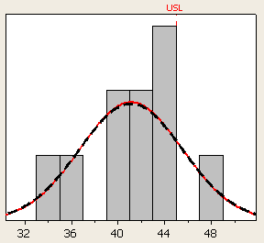
Types of Data - Example
Measurements of dimension of a gap. The example contains 10 measurements. The upper tolerance limit is 45mm. The measurements has to be below this limit to be ok
Measurements 10pc (mm) Variable data Attribute data
42.2 OK
33.1 OK
40.1 OK
43.0 OK
47.5 NOT OK
41.2 OK
35.7 OK
39.3 OK
44.2 OK
44.9 OK
1 NOT OK out of 10 = 10% defect rate

Slide 29
Types of Data
Workout(Solution)
Continuous Data
Discrete Data
Problem / Issue
Continuous Data : A data which uses a measurement scale as well as inches or time.
☞ Contain more information than discrete data.
Discrete Data : A data which is based on information such as pass/fail.
☞ Can’t be more specific
Fire Alarm

Slide 30
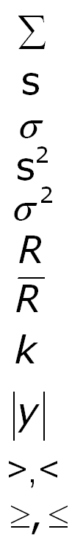
Statistical Notation – Cheat Sheet
Summation
An individual value, an observation
The Standard Deviation of sample data
A particular (1st) individual value
The Standard Deviation of population data
For each, all, individual values
The variance of sample data
The Mean, average of sample data
The variance of population data
The grand Mean, grand average
The range of data
The Mean of population data
The average range of data
Multi-purpose notation, i.e. # of subgroups, # of classes
A proportion of sample data
A proportion of population data
The absolute value of some term
Greater than, less than
Sample size
Greater than or equal to, less than or equal to
Population size
Notes:
Use this as a cheat sheet, don’t bother memorizing all of this. Actually most of the notation in Greek is for population data.

Slide 31
Parameters vs. Statistics
Population: All the items that have the “property of interest” under study.
Frame: An identifiable subset of the population.
Sample: A significantly smaller subset of the population used to make an inference.
Population
Sample
Sample
Sample
Population Parameters:
Arithmetic descriptions of a population
µ, σ , P, σ², N
Sample Statistics:
Arithmetic descriptions of a sample
X-bar , s, p, s², n
Notes:
The purpose of sampling is:
To get a “sufficiently accurate” inference for considerably less time, money and other resources, and also to provide a basis for statistical inference; if sampling is done well, and sufficiently, then the inference is that “what we see in the sample is representative of the population”
A population parameter is a numerical value that summarizes the data for an entire population, a sample has a corresponding numerical value called a statistic.
The population is a collection of all the individual data of interest. It must be defined carefully, such as all the trades completed in 2001. If for some reason there are unique subsets of trades it may be appropriate to define those as a unique population, such as, “all sub custodial market trades completed in 2001”, or “emerging market trades”.
Sampling frames are complete lists and should be identical to a population with every element listed only once. It sounds very similar to population, and it is. The difference is how it is used. A sampling frame, such as the list of registered voters, could be used to represent the population of adult general public. Maybe there are reasons why this wouldn’t be a good sampling frame. Perhaps a sampling frame of licensed drivers would be a better frame to represent the general public.
The sampling frame is the source for a sample to be drawn.
It is important to recognize the difference between a sample and a population because we typically are dealing with a sample of the what the potential population could be in order to make an inference. The formulas for describing samples and populations are slightly different. In most cases we will be dealing with the formulas for samples.

Slide 32
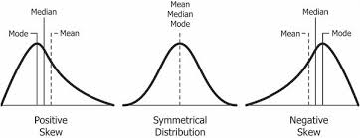
Skewness
Shape of distribution can be symmetric or skewed to one side or the other :
Positively Skewed Symmetric Negatively Skewed

Slide 33
Types of Data
Attribute Data (Qualitative)
Is always binary, there are only two possible values (0, 1)
Yes, No
Go, No go
Pass/Fail
Variable Data (Quantitative)
Discrete (Count) Data
Can be categorized in a classification and is based on counts.
Number of defects
Number of defective units
Number of customer returns
Continuous Data
Can be measured on a continuum, it has decimal subdivisions that are meaningful
Time, Pressure, Conveyor Speed, Material feed rate
Money
Pressure
Conveyor Speed
Notes:
The nature of data of data is important to understand. Based on the type of data you will have the option to utilize different analyses.
Data, or numbers, are usually abundant and available to virtually everyone in the organization. Using data to measure, analyze, improve, and control processes forms the foundation of the Six Sigma methodology. Data turned into information, then transformed into knowledge, lowers the risks of decision. Your goal is to make more decisions based on data versus the typical practices of “I think,” “I feel,” and “In my opinion”.
One of your first steps in refining data into information is to recognize what the type of data is that you are using. There are two primary types of data, they are attribute and variable data.
Attribute Data is also called qualitative data. Attribute Data is the lowest level of data. It is purely binary in nature. Good or bad, yes or no type data. No analysis can be performed on Attribute Data. Attribute Data must be converted to a form of variable data called discrete data in order to be counted or be useful.
Discrete Data is information that can be categorized into a classification. Discrete Data is based on counts. It is typically things counted in whole numbers. Discrete Data is data that can't be broken down into a smaller unit to add additional meaning. Only a finite number of values is possible, and the values cannot be subdivided meaningfully. For example, there is no such thing as a half of defect or a half of a system lockup.
Continuous Data is information that can be measured on a continuum or scale. Continuous Data, also called quantitative data can have almost any numeric value and can be meaningfully subdivided into finer and finer increments, depending upon the precision of the measurement system. Decimal sub-divisions are meaningful with Continuous Data. As opposed to Attribute Data like good or bad, off or on, etc., Continuous Data can be recorded at many different points (length, size, width, time, temperature, cost, etc.). For example 2.543 inches is a meaningful number, whereas 2.543 defects does not make sense.
Later in the course we will study many different statistical tests but it is first important to understand what kind of data you have.

Slide 34
Numerical Data Properties
Central Tendency (Location)
Variation (Dispersion)
Shape
Notes:
Location (Position)
Concerned with where values are concentrated.
Variation (Dispersion)
Concerned with the extent to which values vary.
Shape
Concerned with extent to which values are symmetrically distributed.

Slide 35
Numerical Data Properties & Measure
Numerical Data
Properties
Central
Variation
Shape
Tendency
Mean
Range
Skew
Variance
Median
Standard Deviation
Mode

Slide 36
Numerical Data Properties & Measure
Numerical Data
Properties
Central
Variation
Shape
Tendency
Mean
Range
Skew
Median
Variance
Mode
Standard Deviation

Slide 37
Mean
1. Measure of Central Tendency
2. Most Common Measure
3. Acts as ‘Balance Point’
4. Affected by Extreme Values (‘Outliers’)
5. Formula (Sample Mean)
Sum of all data ( X_{i} )
Number of data (n)
n
∑
X
X
=
i
X
+
X
+
☹
+
X
i
=
1
2
n
=
1
n
n

Slide 38
Mean Example
Raw Data: 10.3 4.9 8.9 11.7 6.3 7.7
10.3
+
4.9
+
8.9
+
11.7
+
6.3
+
7.7
X
=
6
=
8.30

Slide 39
Numerical Data Properties & Measures
Numerical Data
Properties
Central
Variation
Shape
Tendency
Mean
Range
Skew
Median
Variance
Mode
Standard Deviation

Slide 40
Median
1. Measure of Central Tendency
2. Middle Value In Ordered Sequence
If Odd n, Middle Value of Sequence
If Even n, Average of 2 Middle Values
3. Position of Median in Sequence
4. Not Affected by Extreme Values
n
+
1
Positioning
Point
=
2

Slide 41
Numerical Data Properties & Measures
Numerical Data
Properties
Central
Variation
Shape
Tendency
Mean
Range
Skew
Median
Variance
Mode
Standard Deviation

Slide 42
Mode
1. Measure of Central Tendency
2. Value That Occurs Most Often
3. Not Affected by Extreme Values
4. May Be No Mode or Several Modes
5. May Be Used for Numerical & Categorical Data

Slide 43
Mode Example
No Mode Raw Data: 10.3 4.9 8.9 11.7 6.3 7.7
One Mode Raw Data: 6.3 4.9 8.9 6.3 4.9 4.9
More Than 1 Mode Raw Data: 21 28 28 41 43 43

Slide 44
Summary of Central Tendency Measures
Measure
Equation
Description
Mean
Σ
Balance Point
X
/
i
n
(
Median
n
+1)
Position
Middle Value
2
When Ordered
Mode
none
Most Frequent

Slide 45
Numerical Data Properties & Measures
Numerical Data
Properties
Central
Variation
Shape
Tendency
Mean
Range
Skew
Median
Variance
Mode
Standard Deviation

Slide 46
Range
1. Measure of Dispersion
2. Difference Between Largest & Smallest Observations
3. Ignores How Data Are Distributed
Range
=
X
−
X
l
smallest
largest
7
8
9
10
7
8
9
10

Slide 47
Range
Range :
Is a measure of spread and it is calculated by subtracting the smallest number from the largest.
Ex) 4, 5, 7, 11, 14, 14, 15
Range = max – min = 15 – 4 = 11

Slide 48
Numerical Data Properties & Measures
Numerical Data
Properties
Central
Tendency
Variation
Shape
Mean
Range
Skew
Median
Variance
Mode
Standard Deviation

Slide 49
Standard Deviation
Measures of Dispersion
Most Common Measures
Consider How Data Are Distributed
Show Variation About Mean (‾X or μ)
‾
X
= 8.3
4
6
8
10
12

Slide 50
Standard Deviation
Standard deviation :
The average of the distances between the observations and the mean…
time (sec)
8
7
6
5
x
4
4.4
Mean
3
2
1
Observation
Standard deviation has the same dimension as the measurements
(e.g., mm, seconds, kg)

Slide 51
Standard Deviation
Standard deviation :
Commonly used measurements for spread represented by σ and calculated by the formula :
= √
σ
( X₁ – X)² + (X₂ – X)² + …+ ( X_{n} - X)²
n-1
Where X = mean
X_{1,} X_{2 ….} = the values in our group of data
n = the number of values in our group of data
Other denotations for the standard deviation is s and Sigma

Slide 52
Standard Deviation
Standard deviation :
Ex. 1, 2, 3, 4, 5 X = 3
= √
s
( 1– 3)² + (2 – 3)² + (3-3)² + (4-3)² + (5-3)²
5-1
√(-2)² + (-1)² + (0)² + (1)² + (2)²
√ 4 + 1 + 0 + 1 + 4
=
=
4
4
√ 10 / 4
√ 2.5
= 1.58
=
=

Slide 53
1d.3 – Outlier Treatments

Slide 54
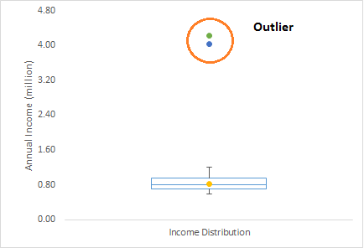
DATA TREATMENTS
Outlier is a commonly used terminology by analysts and data scientists as it needs close attention else it can result in wildly wrong estimations. Simply speaking, Outlier is an observation that appears far away and diverges from an overall pattern in a sample.
Let’s take an example, we do customer profiling and find out that the average annual income of customers is $0.8 million. But, there are two customers having annual income of $4 and $4.2 million. These two customers annual income is much higher than rest of the population. These two observations will be seen as Outliers.

Slide 55
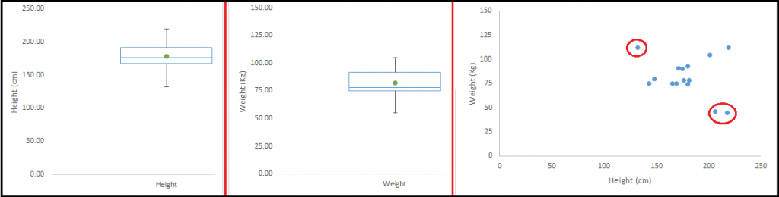
What are the types of Outliers?
Outlier can be of two types: Univariate and Multivariate. Above, we have discussed the example of univariate outlier. These outliers can be found when we look at distribution of a single variable. Multi-variate outliers are outliers in an n-dimensional space. In order to find them, you have to look at distributions in multi-dimensions.
Let us understand this with an example. Let us say we are understanding the relationship between height and weight. Below, we have univariate and bivariate distribution for Height, Weight. Take a look at the box plot. We do not have any outlier (above and below 1.5*IQR, most common method). Now look at the scatter plot. Here, we have two values below and one above the average in a specific segment of weight and height.

Slide 56
What causes Outliers?
Whenever we come across outliers, the ideal way to tackle them is to find out the reason of having these outliers. The method to deal with them would then depend on the reason of their occurrence.
Causes of outliers can be classified in two broad categories:
Artificial (Error) / Non-natural
Natural

Slide 57
Data Entry Errors:
Human errors such as errors caused during data collection, recording, or entry can cause outliers in data. For example: Annual income of a customer is $100,000. Accidentally, the data entry operator puts an additional zero in the figure. Now the income becomes $1,000,000 which is 10 times higher. Evidently, this will be the outlier value when compared with rest of the population.
Measurement Error:
It is the most common source of outliers. This is caused when the measurement instrument used turns out to be faulty. For example: There are 10 weighing machines. 9 of them are correct, 1 is faulty. Weight measured by people on the faulty machine will be higher / lower than the rest of people in the group. The weights measured on faulty machine can lead to outliers.
Experimental Error:
Another cause of outliers is experimental error. For example: In a 100m sprint of 7 runners, one runner missed out on concentrating on the ‘Go’ call which caused him to start late. Hence, this caused the runner’s run time to be more than other runners. His total run time can be an outlier.

Slide 58
Intentional Outlier:
This is commonly found in self-reported measures that involves sensitive data. For example: Teens would typically under report the amount of alcohol that they consume. Only a fraction of them would report actual value. Here actual values might look like outliers because rest of the teens are under reporting the consumption.
Data Processing Error:
Whenever we perform data mining, we extract data from multiple sources. It is possible that some manipulation or extraction errors may lead to outliers in the dataset.
Sampling error:
For instance, we have to measure the height of athletes. By mistake, we include a few basketball players in the sample. This inclusion is likely to cause outliers in the dataset.
Natural Outlier:
When an outlier is not artificial (due to error), it is a natural outlier. For instance: In my last assignment with one of the renowned insurance company, I noticed that the performance of top 50 financial advisors was far higher than rest of the population. Surprisingly, it was not due to any error. Hence, whenever we perform any data mining activity with advisors, we used to treat this segment separately.

Slide 59
What is the impact of Outliers on a dataset?
Outliers can drastically change the results of the data analysis and statistical modelling. There are numerous unfavourable impacts of outliers in the data set:
It increases the error variance and reduces the power of statistical tests
If the outliers are non-randomly distributed, they can decrease normality
They can bias or influence estimates that may be of substantive interest
They can also impact the basic assumption of Regression, ANOVA and other statistical model assumptions.

Slide 60
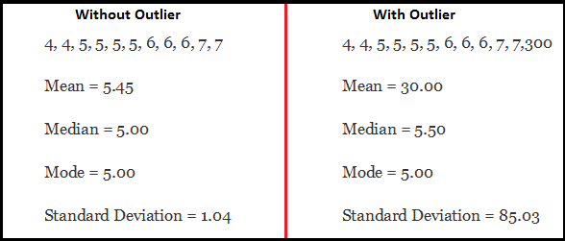
To understand the impact deeply, let’s take an example to check what happens to a data set with and without outliers in the data set.
As one can see, data set with outliers has significantly different mean and standard deviation. In the first scenario, we will say that average is 5.45. But with the outlier, average soars to 30. This would change the estimate completely.

Slide 61
How to detect Outliers?
Most commonly used method to detect outliers is visualization. We use various visualization methods, like Box-plot, Histogram, Scatter Plot (above, we have used box plot and scatter plot for visualization). Some analysts also various thumb rules to detect outliers.
Some of them are:
Any value, which is beyond the range of -1.5 x IQR to 1.5 x IQR
Use capping methods. Any value which out of range of 5th and 95th percentile can be considered as outlier
Data points, three or more standard deviation away from mean are considered outlier
Outlier detection is merely a special case of the examination of data for influential data points and it also depends on the business understanding
Bivariate and multivariate outliers are typically measured using either an index of influence or leverage, or distance. Popular indices such as Mahalanobis’ distance and Cook’s D are frequently used to detect outliers.
In SAS, we can use PROC Univariate, PROC SGPLOT. To identify outliers and influential observation, we also look at statistical measure like STUDENT, COOKD, RSTUDENT and others.

Slide 62
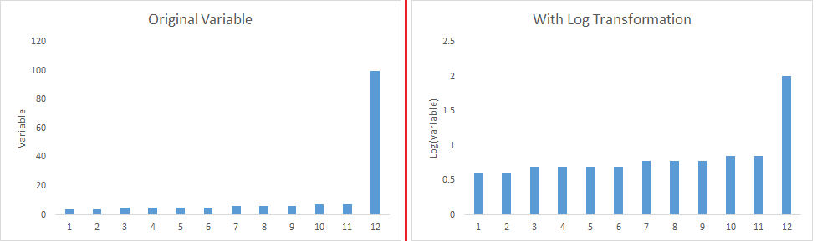
How to remove Outliers?
Most of the ways to deal with outliers are similar to the methods of missing values like deleting observations, transforming them, binning them, treat them as a separate group, imputing values and other statistical methods. Here, we will discuss the common techniques used to deal with outliers:
Deleting observations: We delete outlier values if it is due to data entry error, data processing error or outlier observations are very small in numbers. We can also use trimming at both ends to remove outliers.
Transforming and binning values: Transforming variables can also eliminate outliers. Natural log of a value reduces the variation caused by extreme values. Binning is also a form of variable transformation. Decision Tree algorithm allows to deal with outliers well due to binning of variable. We can also use the process of assigning weights to different observations.

Slide 63
Imputing: Like imputation of missing values, we can also impute outliers. We can use mean, median, mode imputation methods. Before imputing values, we should analyse if it is natural outlier or artificial. If it is artificial, we can go with imputing values. We can also use statistical model to predict values of outlier observation and after that we can impute it with predicted values.
Treat separately: If there are significant number of outliers, we should treat them separately in the statistical model. One of the approach is to treat both groups as two different groups and build individual model for both groups and then combine the output.

Slide 64
Duplicates
Duplicate records in analytics, also known as duplicate rows, are identical rows in a csv or a table
This means, for a pair of duplicate records, the values in each column coincide
Usually, we will retrieve duplicate data, when we are joining tables

Slide 65
Data Summarization

Slide 66
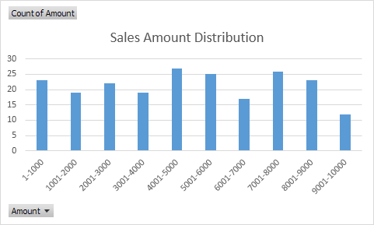
Frequency distribution
Frequency distribution is a representation, either in a graphical or tabular format, that displays the number of observations within a given interval.
Frequency distributions are typically used within a statistical context.
Cumulative frequencies are obtained by accumulating the frequencies to give the total number of observations up to and including the value or group in question

Slide 67
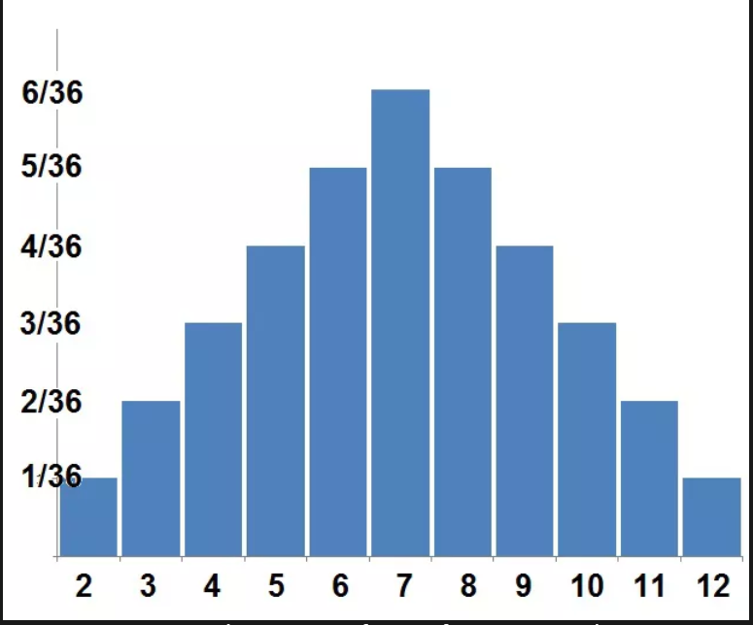
Probability Distribution
As a simple example of a probability distribution, let us look at the number observed when rolling two standard six-sided dice.
Each die has a 1/6 probability of rolling any single number, one through six, but the sum of two dice will form the probability distribution depicted in the image here.
Seven is the most common outcome (1+6, 6+1, 5+2, 2+5, 3+4, 4+3).
Two and twelve, on the other hand, are far less likely (1+1 and 6+6).

Slide 68

A random variable is a variable whose possible values are outcomes of a random phenomenon
Type of Probability Distribution
Discrete Random
Here possible outcomes can be counted and we can create probability density function
Continuous
Range will be negative infinite to positive infinite
Normal / Gaussian
Binomial – e.g. no of heads in two tosses ( Bernoulli process )
Poison – e.g. no fo call coming in
Central Limit Theorem

Slide 69
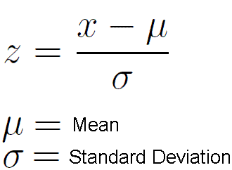
What is Z score
Simply put, a z-score is the number of standard deviations from the mean a data point is. But more technically it’s a measure of how many standard deviations below or above the population mean a raw score is. A z-score is also known as a standard score and it can be placed on a normal distribution curve.

Slide 70
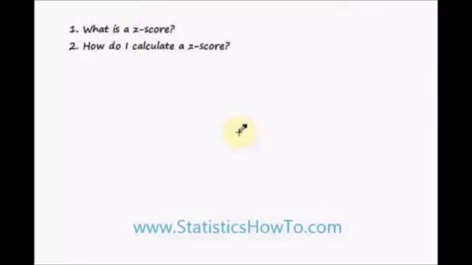
Z-Score
Video

Slide 71
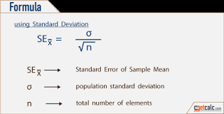
Point estimates
Confidence interval
These are the single values used to estimate population parameters
e.g. Age = 20
It is a range of values in which the population parameter is expected to be in
e.g. age is 20 to 25
Confidence interval takes on the following form where N ≥ 30
Confidence Interval = μ + Z*σ
Where, μ is the mean of the population
σ is the standard deviation of the population

Slide 72
95% confidence Interval
A 95% confidence interval is a range of values that you can be 95% certain contains the true mean of the population.
But only a tiny fraction of the values in the large sample on the right lie within the confidence interval.
Lets say from population we take 100 samples.
Considering normal distribution all the means of sample should also lie in
+ 2σ or −2σ of population mean.

Slide 73
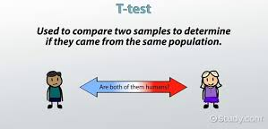
T test
A t-test is a type of inferential statistic used to determine if there is a significant difference between the means of two groups, which may be related in certain features.
A t-test is used as a hypothesis testing tool, which allows testing of an assumption applicable to a population.

Slide 74
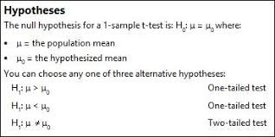
Type of t test

Slide 75
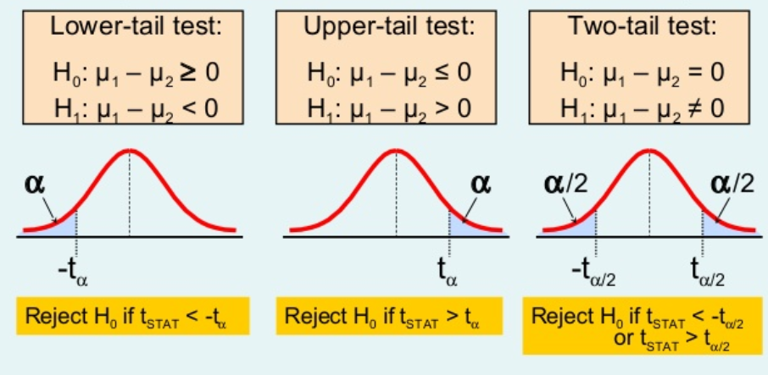
Type of T test* : 2 population means
* For independent t test the sample are independent while for dependent t test samples are dependent

Slide 76
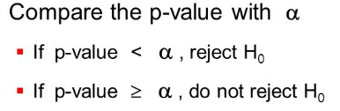
P-value
Lets assume alpha = 0.05
Why 0.05 ?
If we take 100 samples from population then as per normality we will get 95% samples within +2 or -2 Standard deviation
Anything beyond disobeys the normal
Thus, Alpha = 5% &
Confidence Interval is 95%

Slide 77
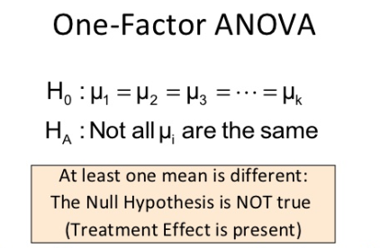
Anova
An ANOVA test is a way to find out if survey or experiment results are significant.
In other words, they help you to figure out if you need to reject the null hypothesis or accept the alternate hypothesis.
Basically, you’re testing groups to see if there’s a difference between them.

Slide 78
Chi square
The Chi Square statistic is commonly used for testing relationships between categorical variables. The null hypothesis of the Chi-Square test is that no relationship exists on the categorical variables in the population; they are independent.

Slide 79
F test
An F-test is any statistical test in which the test statistic has an F-distribution under the null hypothesis. It is most often used when comparing statistical models that have been fitted to a data set, in order to identify the model that best fits the population from which the data were sampled.

Slide 80


